Slide 1
Rajalakshmi ’supply chain project

Slide 2
Team Detail
Mentor : Dr.G Sai krishnan
Vishnu S
Antony Santhan Raj A
Abhishai Anandaraj J
Tamilarasan C
Swaminathan K S
Athithya T
Vishal J
Reshma R
Rahavi S
Roshini
Vidhya Bharathi

Slide 3
Action Taken Report
Suggestion That given :
Advised to work on the classify and profiling the car with age of it
To analyze the any correlation for specific vehicle
Management of the stocking of vehicle parts
Do a research on Third party warrant and Maruti Suzuki

Slide 4
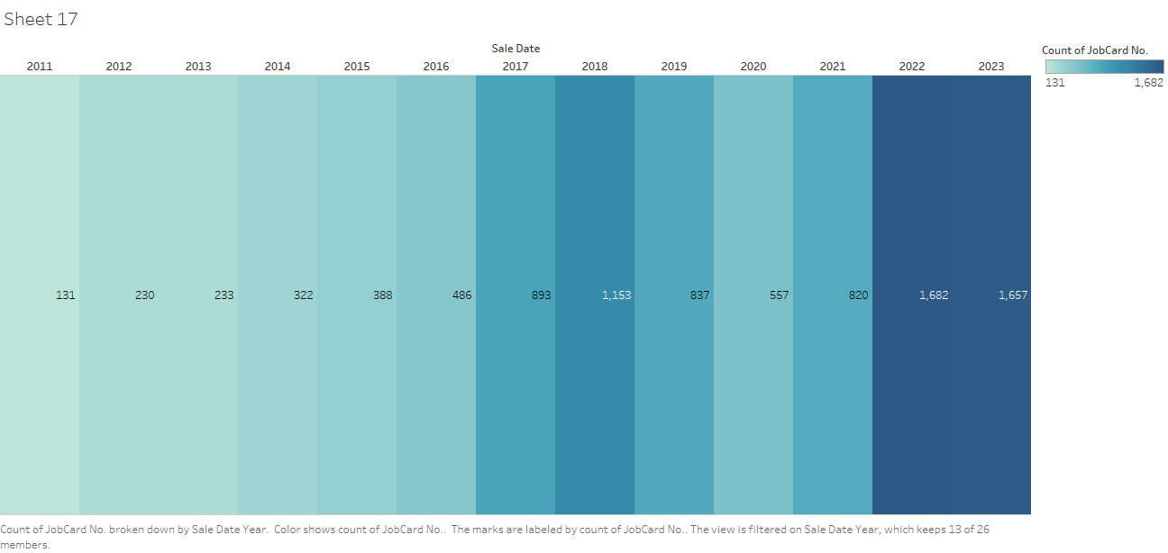
Age Profiling with their sale date
Richard Branson

Slide 5
New Customers encounter by
VISHNU CARS PVT
Under PMS = 671
AIE CARS
Car India PVT
Cresso
OUT OF 9,666
Under FR = 812
GANESH CARS
J.J.IMPEX LTD
2,100
were newcomer or changed center
KHIVIRAJ MOTORS
Under unknown = 617
POPULAR VEHICLES
VISHNU CARS

Slide 6
MARUTHI SUZUKI INSURANCE
ADVANTAGES
DISADVANTAGES
SEAMLESS INTEGRATION: Since the insurance is provided by the same company that manufactured your car, the insurance process can be seamlessly integrated with your car purchase and servicing.
But it's more often that the quoted price is much higher than the policies available in open market. So be sure to bargain hard and ask to omit unnecessary coverages from the list.
TRUST AND RELIABILITY: Choosing an in-house insurance from Maruti Suzuki may provide a sense of trust and reliability, as the company has a vested interest in ensuring the best coverage for their customers.
TAILORED COVERAGE: Maruti Suzuki may offer insurance plans specifically tailored to their vehicles, providing coverage that aligns closely with the needs of their customers.

Slide 7
Third-Party Insurance
ADVANTAGES
DISADVANTAGES
It's cheaper: Third-party insurance usually costs less than what Maruti Suzuki offers.
You have more choices: You can pick from different insurance companies and find the one that gives you the best deal.
You can get special coverage: Some third-party insurers might offer extra benefits that Maruti Suzuki doesn't provide.
It covers less: Third-party insurance only pays for damage to other people's property in an accident, not your own car.
It's not as convenient: It might not be as easy to set up insurance with a third-party company compared to getting it through Maruti Suzuki.
Some people worry about how reliable third-party insurers are compared to big companies like Maruti Suzuki.

Slide 8
Warranty
B2B MARKET SCENARIOS
CLOUD-BASED OPPORTUNITIES
Develop winning strategies to keep ahead of the competition
​Capitalize on low-hanging fruit to identify a ballpark value
​Visualize customer directed convergence​
Iterative approaches to corporate strategy
​Establish a management framework from the inside​

Slide 9
What planned to do

Slide 10
Correlation with specific cars
At Contoso, we believe in giving 110%. By using our next-generation data architecture, we help organizations virtually manage agile workflows. We thrive because of our market knowledge and great team behind our product. As our CEO says, "Efficiencies will come from proactively transforming how we do business."​

Slide 11
THANK YOU
Any questions ?

